Slide 1

Shifting energetic compensation over time in a desert rodent community
April 22, 2021 – UF SNRE Student Research Symposium
Renata Diaz and S. K. Morgan Ernest

Slide 2
Background

Slide 3
Total energy flux
The metabolic rates of all the individual organisms in a community add up to the community-level rate of energy use, total energy flux
Total energy flux is a direct metric of assemblage-level function and resource use

Slide 4
Energetic compensation
Energetic compensation occurs when declines in energy use from some species are offset by gains from others
Energetic compensation renders total energy flux resilient to species-level fluctuations

Slide 5
Species overlap
For energetic compensation to occur, there must be functional overlap between species in a community
If overlapping species are not present, compensation may be delayed until a suitable species joins the community

Slide 6
Shifting conditions modulate overlap
Species often differ in their responses to shifting conditions
Differential responses to change may modulate overlap between species

Slide 7
Transient, contingent compensation
If changing conditions reduce or increase the overlap between species…
Energetic compensation may be temporary and contingent, not a fixed attribute of a community

Slide 8
Compensation in desert rodents

Slide 9
Portal, AZ: Kangaroo rats are dominant consumers

Slide 10
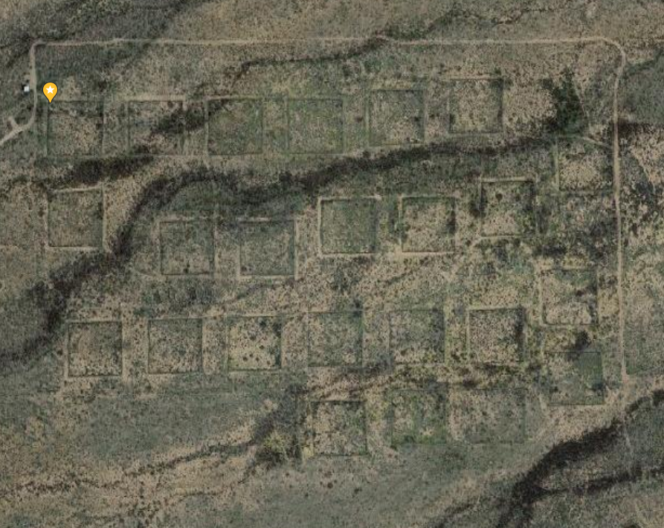
Experimental exclosures selectively remove kangaroo rats

Slide 11
Smaller granivores compensate

Slide 12
Compensation driven by C. baileyi

Slide 13
Conditions at the site have changed
A 40-year shift from grassland to shrubland
A long-term decrease in kangaroo rat relative abundance
Following a drought in 2010, a sharp decline in C. baileyi

Slide 14
How has compensation changed following the decline of C. baileyi?

Slide 15
Compensation has reverted to pre-C. baileyi levels

Slide 16
Total energy use has declined, but remains higher than pre-C. baileyi

Slide 17
C. baileyi: No longer an analog
Under conditions 1996-2010, C. baileyi was able to functionally compensate for kangaroo rats
Under current conditions, it fails to do so

Slide 18
Smaller granivores: more consistent
Despite an overall shift favoring small granivores, compensation from small granivores has not increased

Slide 19
Compensation: transient, contingent, and slow

